Slide 1
Tweet Sentiment Classifier using Flask and Machine Learning
AIDI 1003 – Machine Learning Frameworks

Slide 2
Team Members:
Name | Student ID | Role Description
Akshit Sharma | 200577950 | Data Cleaning & Preprocessing
Jomol Joy | 200577097 | Exploratory Data Analysis & Visualizations
Priyanka Thomas | 200587559 | Model Training, Tuning & Evaluation
Sanat Sunny | 200576550 | Deployment (Flask API) & Final Presentation Prep

Slide 3

Problem Statement
Social media is an ever-growing source of real-time public opinion. Platforms like Twitter are used by individuals to express their views on various topics ranging from politics to products. With millions of tweets posted daily, manually analyzing sentiments becomes impractical. Our project addresses this problem by building an automated system that classifies tweets into positive or negative sentiments using machine learning. The final product is a deployable web API that can be integrated into larger systems for real-time sentiment analysis.

Slide 4
Project Objectives
The primary objectives of our project are as follows:
To preprocess raw tweet data and prepare it for analysis.
To explore and visualize trends in the data using EDA techniques.
To build and evaluate robust machine learning models for binary sentiment classification.
To deploy the best-performing model using a lightweight Flask-based API.
To validate the deployed model through real-time POST requests using Postman.

Slide 5
Dataset Overview
We used the Sentiment140 dataset available on Kaggle, which contains 1.6 million tweets annotated for sentiment. The dataset includes tweet content, sentiment labels, and user metadata. For our purposes, we focused on the text and sentiment columns. Tweets originally labeled as 0 (negative) and 4 (positive) were relabeled to 0 and 1 respectively for binary classification. The large volume of data provided a robust base for model training and evaluation.

Slide 6
Data Cleaning Process
Raw tweets contain a lot of noise such as user mentions, hashtags, URLs, emojis, and other special characters. Our cleaning process involved several steps:
Removing URLs and hyperlinks using regular expressions.
Eliminating Twitter handles (e.g., @usernames) and hashtags.
Converting all text to lowercase to ensure consistency.
Removing punctuation, numbers, and extra whitespace.
Tokenizing and vectorizing the cleaned text for model input. This resulted in a cleaner, more uniform dataset ready for feature extraction.

Slide 7
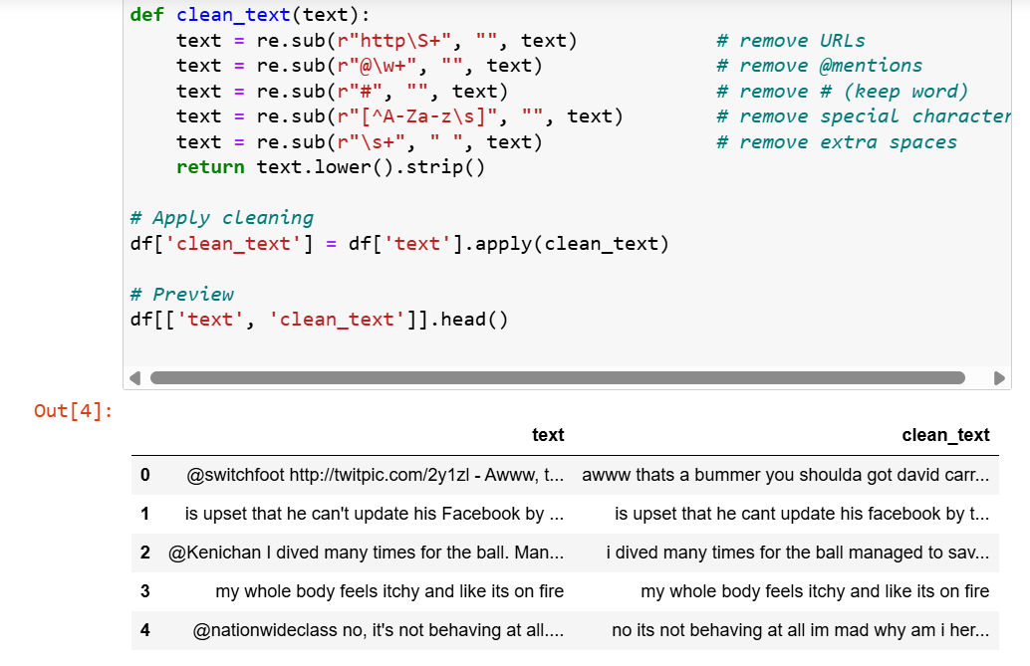
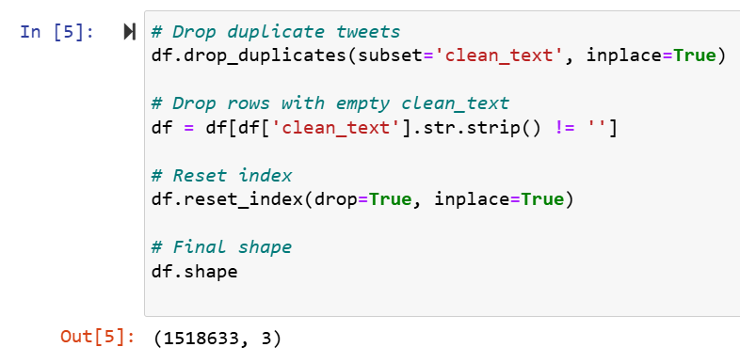
Cleaning the Dataset

Slide 8

EDA & Visualizations
Exploratory Data Analysis helped us understand the distribution and frequency of terms across sentiments. Key insights included:
An almost balanced distribution between positive and negative tweets.
Word clouds highlighting distinct vocabulary in positive vs. negative tweets.
Top 20 most common words featured neutral terms, indicating a need for contextual analysis.

Slide 9
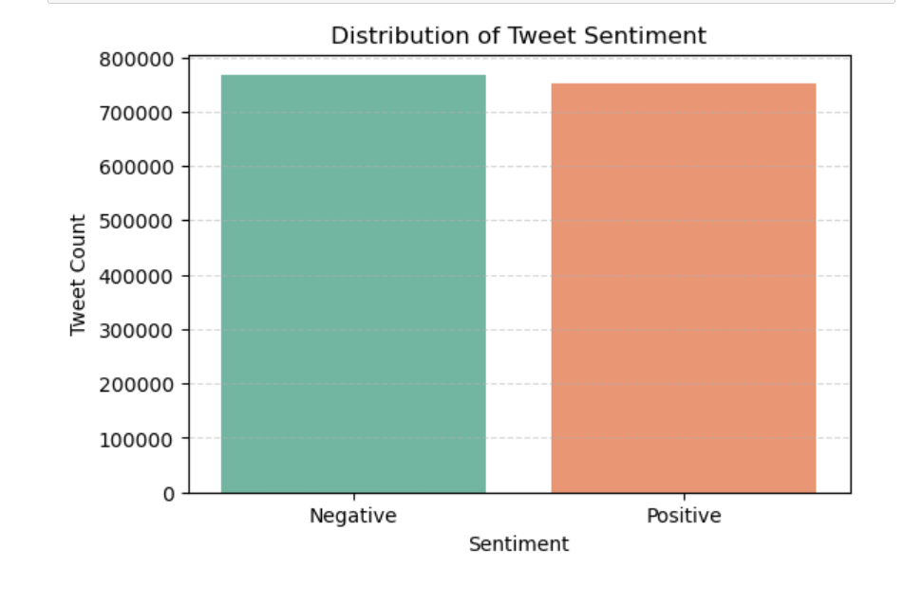
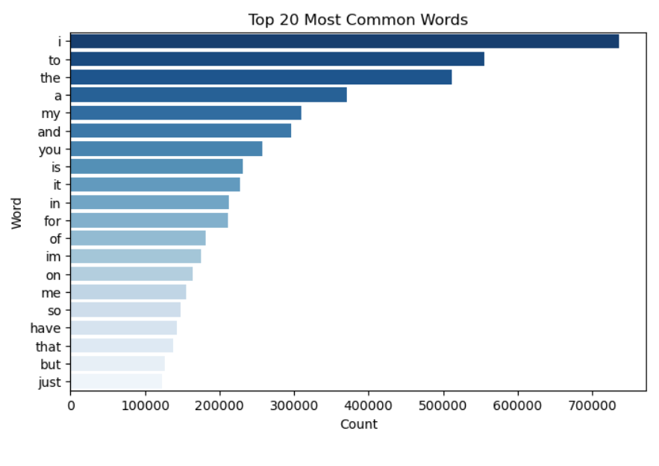
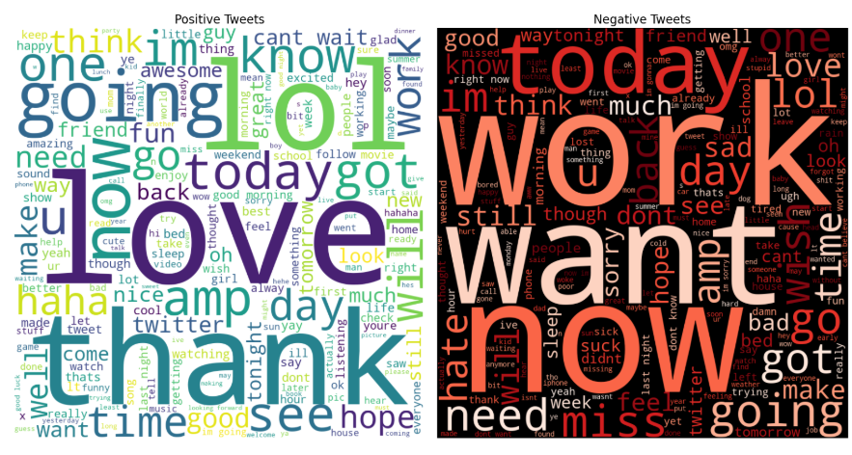

Slide 10

Model Training & Evaluation
The preprocessed tweets were vectorized using the TF-IDF technique with a limit of 5000 features. We trained two models:
Logistic Regression, which achieved the highest accuracy.
Multinomial Naive Bayes, used for comparison. We further optimized Logistic Regression using GridSearchCV and performed cross-validation to ensure robustness. The final model achieved an accuracy of approximately 79% with balanced precision and recall.

Slide 11
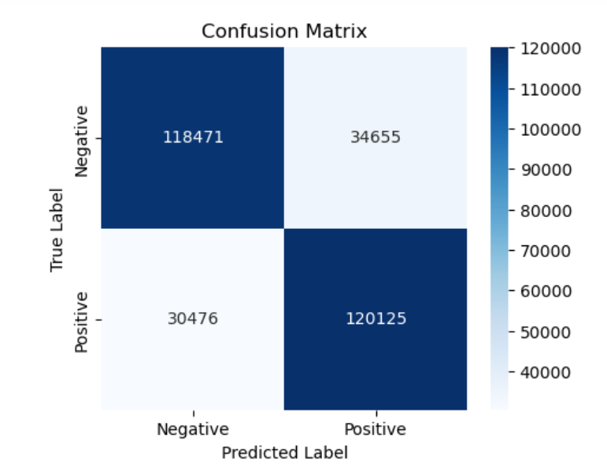
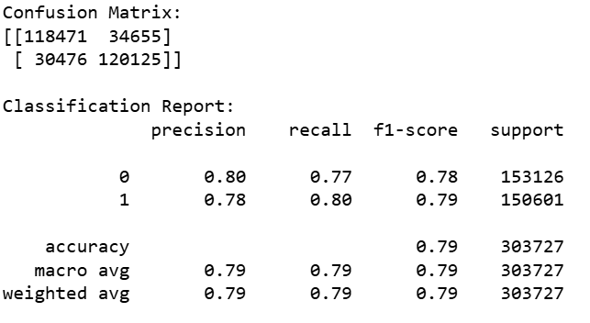

Slide 12
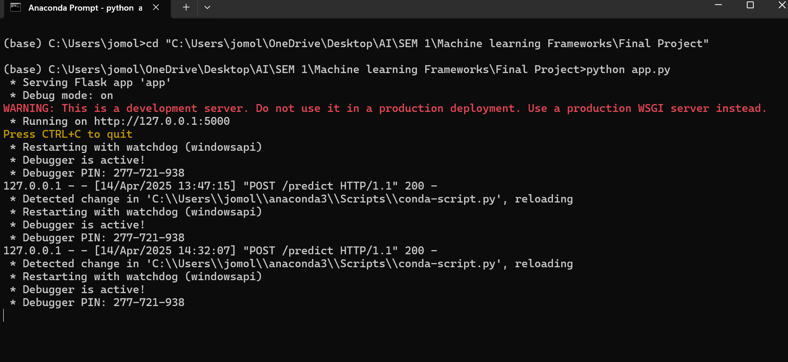
Model Deployment using Flask
After finalizing the best model, we serialized it using joblib and built a simple Flask app to expose it as an API. The /predict endpoint accepts a JSON object with the tweet text, applies the same cleaning and vectorization steps, and returns the predicted sentiment. The app runs locally and can be tested at http://127.0.0.1:5000 .

Slide 13
Postman API Testing
To verify our deployment, we used Postman to simulate user requests. We sent POST requests to the /predict endpoint with different tweet samples. The server returned real-time predictions as JSON responses, validating that the Flask API could successfully serve the model.

Slide 14
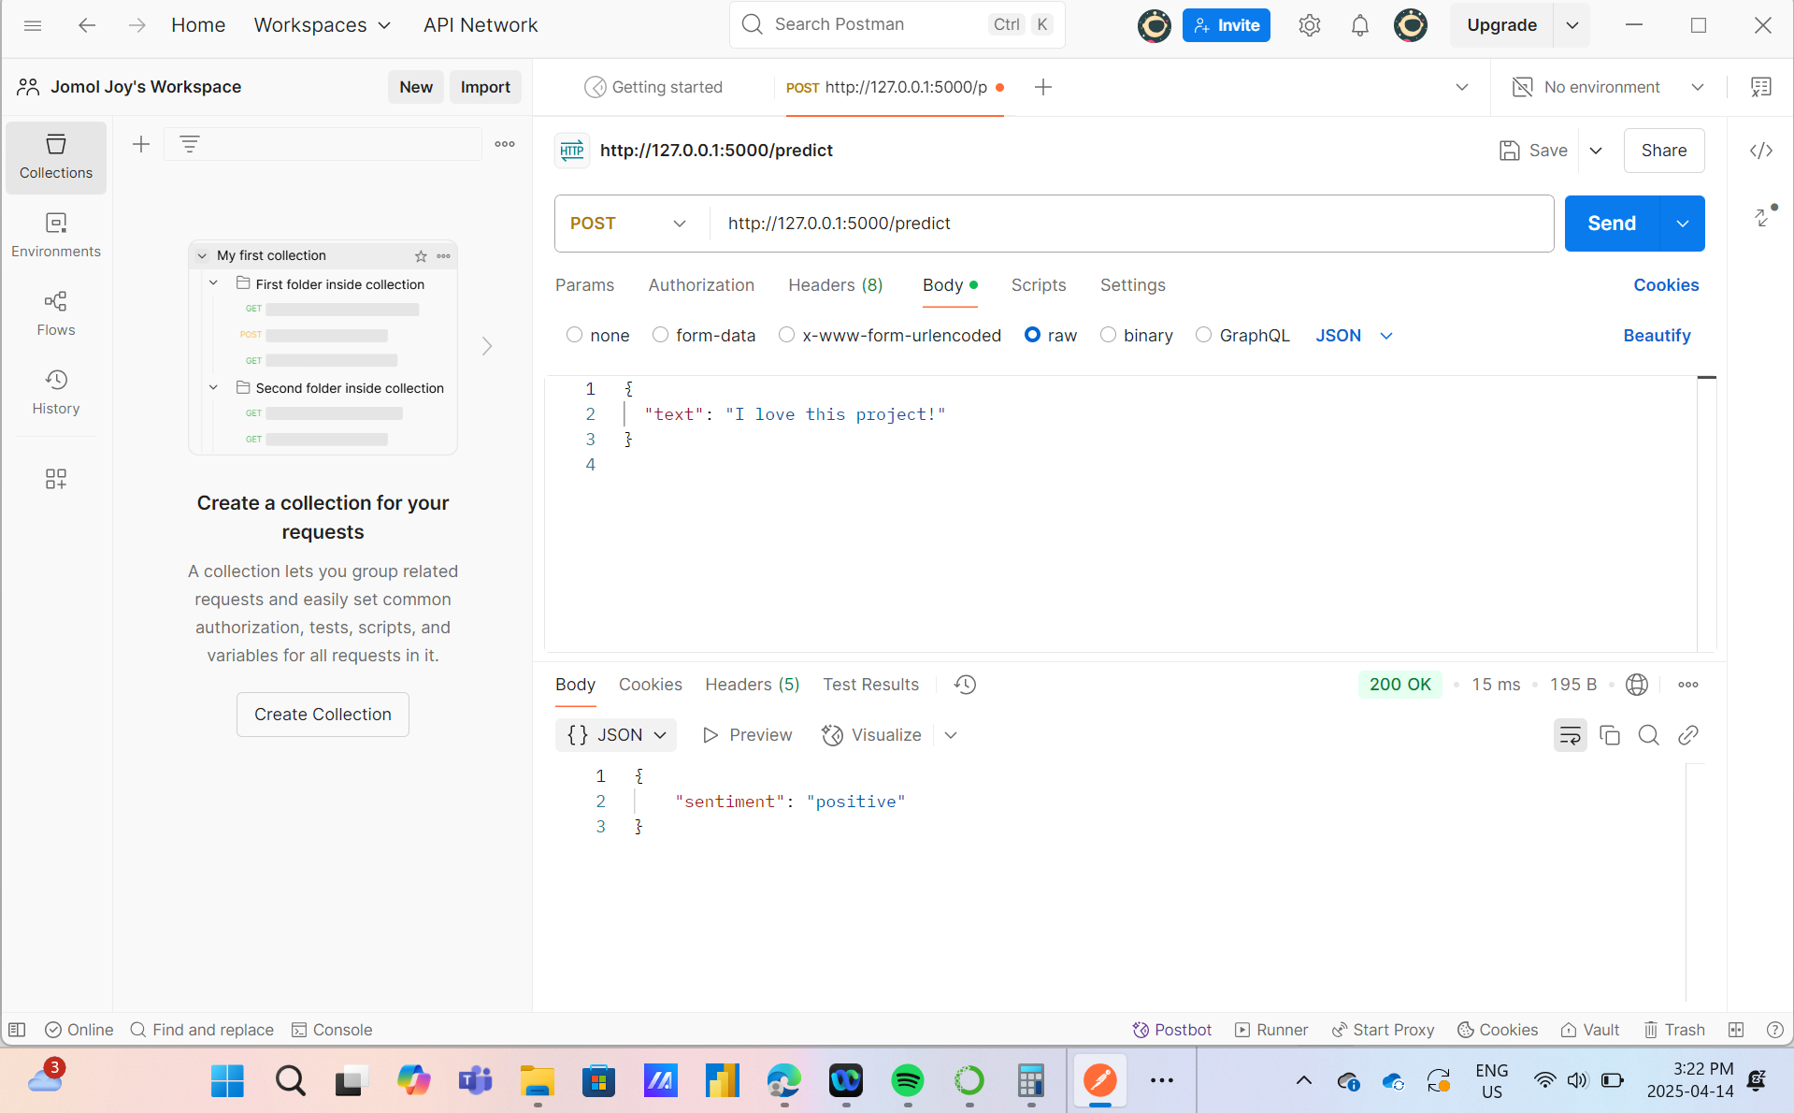
Postman API Testing

Slide 15
Results & Observations
Logistic Regression showed better performance than Naive Bayes.
F1-scores and accuracy remained consistent across multiple validation runs.
EDA provided meaningful insight into the linguistic structure of tweets.
Postman testing confirmed the Flask app was responsive and reliable.
The system is lightweight and can easily be scaled or deployed online.

Slide 16
Conclusion & Future Enhancements
This project successfully demonstrates an end-to-end sentiment classification pipeline from data ingestion to real-time deployment. The Flask-based web API enables practical usage and integration with other systems.
Future Enhancements:
Introduce a third sentiment class: neutral.
Use deep learning models like BERT or LSTM for improved accuracy.
Connect to Twitter’s live API for dynamic tweet sentiment tracking.
Deploy the model on cloud platforms such as AWS EC2 or Heroku for public access.

Slide 17
Thank You

